Slide 1
Chapter 6
E-commerce Payment Systems
Copyright © 2014 Pearson Education, Inc. Publishing as Prentice Hall

Slide 2
Types of Payment Systems
Cash
  Most common form of payment
  Instantly convertible into other forms of value
  No float
Checking transfer (Cheque)
  Second most common payment form in United States
Credit card
  Credit card associations (VISA, Mastercard)
  Issuing banks
  Processing centers are clearing houses.
Copyright © 2014 Pearson Education, Inc. Publishing as Prentice Hall
Slide 5-<number>

Slide 3
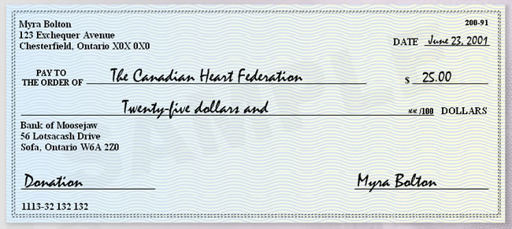
Cheque
Copyright © 2014 Pearson Education, Inc. Publishing as Prentice Hall
Slide 5-<number>

Slide 4
Cheque
Advantages
  Don’t need to carry cash around
  Stopping payment if necessary
Disadvantages
  Don’t know who actually receive the money
  Takes time to clear
  Cheque can be denied
Copyright © 2014 Pearson Education, Inc. Publishing as Prentice Hall
Slide 5-<number>

Slide 5
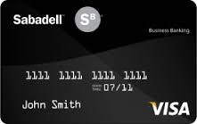
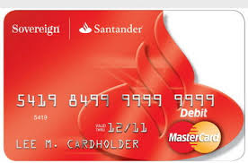
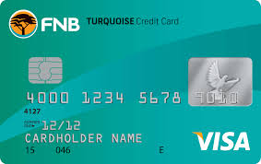
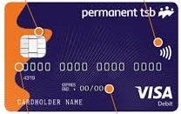
Credit cards
Copyright © 2014 Pearson Education, Inc. Publishing as Prentice Hall
Slide 5-<number>

Slide 6
Credit cards
Card associations: nonprofit associations that set standards for the issuing banks
VISA
Mastercard
American Express
…
Copyright © 2014 Pearson Education, Inc. Publishing as Prentice Hall
Slide 5-<number>

Slide 7
Credit cards
Vietnam card associations:
VNBC
Banknetvn
Smartlink
Copyright © 2014 Pearson Education, Inc. Publishing as Prentice Hall
Slide 5-<number>

Slide 8
E-commerce Payment Systems
Credit cards
  42% of online payments in 2013 (United States)
Debit cards
  29% online payments in 2013 (United States)
Limitations of online credit card payment
  Security, merchant risk
  Cost
  Social equity
Copyright © 2014 Pearson Education, Inc. Publishing as Prentice Hall
Slide 5-<number>

Slide 9
Credit card
Borrowing-lending relationship between cardholders and banks
Credit limit/borrowing limit
Statement
Due date
Minimum payment
Interest
Copyright © 2014 Pearson Education, Inc. Publishing as Prentice Hall
Slide 5-<number>

Slide 10
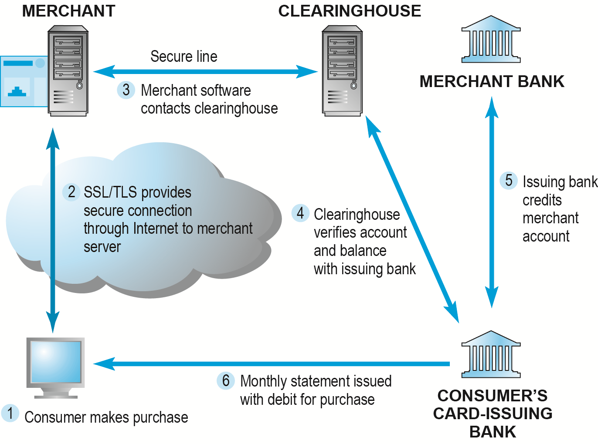
How an Online Credit Transaction Works
Figure 5.15, Page 302
Copyright © 2014 Pearson Education, Inc. Publishing as Prentice Hall
Slide 5-<number>

Slide 11
Credit card
Chargeback
OTP (One-time PIN)
Copyright © 2014 Pearson Education, Inc. Publishing as Prentice Hall
Slide 5-<number>

Slide 12
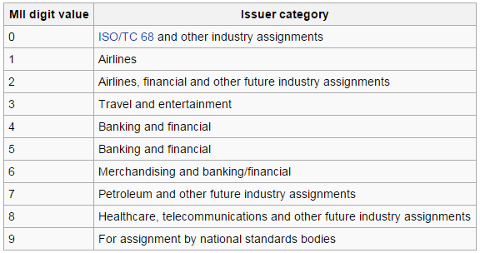
Card Digits’ Meaning
The first digit: Major Industry Identifier (MII)
Copyright © 2014 Pearson Education, Inc. Publishing as Prentice Hall
Slide 5-<number>

Slide 13
Card Digits’ Meaning
The first six digits (including MII): Issuer Identification Number (IIN): help identifying exactly what bank the card belongs to
Example: The first six digits on VISA card of Vietnam HSBC are 445093
Copyright © 2014 Pearson Education, Inc. Publishing as Prentice Hall
Slide 5-<number>

Slide 14
Card Digits’ Meaning
The next nine digits: cardholder’s account number, which is allocated by cardholder’s issued bank
The last digit: checksum digit
Copyright © 2014 Pearson Education, Inc. Publishing as Prentice Hall
Slide 5-<number>

Slide 15
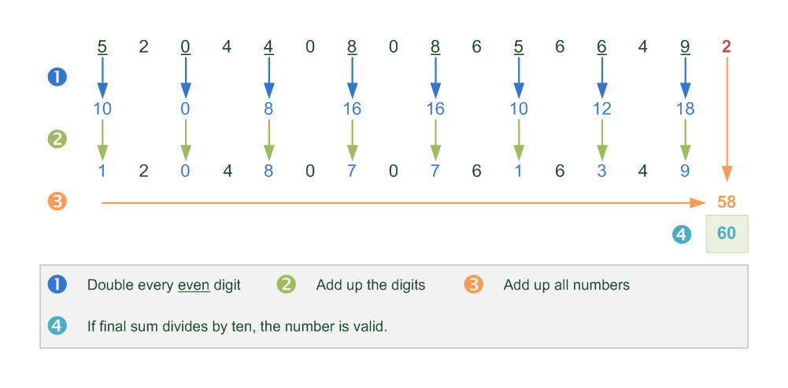
Luhn Algorithm
Copyright © 2014 Pearson Education, Inc. Publishing as Prentice Hall
Slide 5-<number>

Slide 16
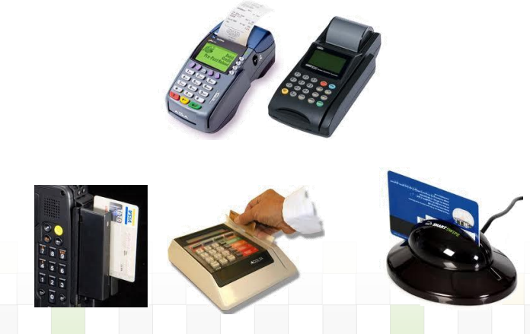
POS Devices
Copyright © 2014 Pearson Education, Inc. Publishing as Prentice Hall
Slide 5-<number>

Slide 17
Types of Payment Systems (cont.)
Stored value
  Funds deposited into account, from which funds are paid out or withdrawn as needed
  Examples:
  Debit cards
  Gift certificates
  Prepaid card
  Smart card
  Peer-to-peer (Paypal)
Copyright © 2014 Pearson Education, Inc. Publishing as Prentice Hall
Slide 5-<number>

Slide 18
Debit Card
Use your own money
Annual fee
Chargeback
OTP
ATM
Copyright © 2014 Pearson Education, Inc. Publishing as Prentice Hall
Slide 5-<number>

Slide 19
Cash Card
Don’t want to take money around
Too young to have credit cards
No PINs
No signatures
Copyright © 2014 Pearson Education, Inc. Publishing as Prentice Hall
Slide 5-<number>

Slide 20
Electronic Wallet
Personal information
Electronic cash
Bank account
Driver’s license
Heath card
…
Copyright © 2014 Pearson Education, Inc. Publishing as Prentice Hall
Slide 5-<number>

Slide 21
Alternative Online Payment Systems
Online stored value systems:
  Based on value stored in a consumer’s bank, checking, or credit card account
  Example: PayPal
Other alternatives:
  Amazon Payments
  Google Checkout
  Other online payment gates
Copyright © 2014 Pearson Education, Inc. Publishing as Prentice Hall
Slide 5-<number>

Slide 22
Digital Cash and Virtual Currencies
Digital cash
  Based on algorithm that generates unique tokens that can be used in “real” world
  Example: Bitcoin
Virtual currencies
  Circulate within internal virtual world
  Example: Linden Dollars in Second Life, Facebook Credits
Copyright © 2014 Pearson Education, Inc. Publishing as Prentice Hall
Slide 5-<number>

Slide 23
Discussion
Why does Amazon refuse to ship to some countries?
Compare credit card with debit card. Which one would you be interested in and why?
Have you ever purchased anything online? What kind of payment did you use?
Copyright © 2014 Pearson Education, Inc. Publishing as Prentice Hall
Slide 5-<number>

